Slide 1
Front End Engineering
Project - 1

Slide 2

Digital Music Player
Presented
By
Dhruv Garg 2210990273
Divyansh 2210990298
Gagan Deep 2210990310
Faculty Coordinator : Parul Gehlot
Chitkara University Institute of Engineering and Technology,

Slide 3

Contents
Introduction
Motivation of Research
Tools & Technologies
Project Highlights: 1
Project Highlights: 2
Project Highlights: 3
Conclusion/Theme Plan
References

Slide 4
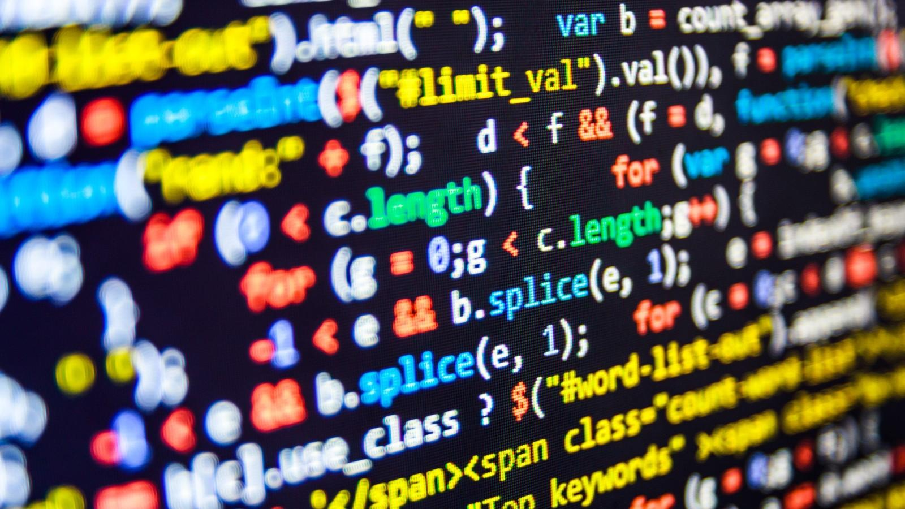
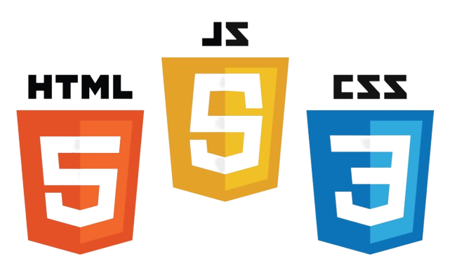

Introduction
"This is a customized version of the famous music streaming service. Here you can listen to music, and enjoy a personalized music experience."
In our presentation, we'll explore the key features , how it works, and why it's an exciting opportunity for innovation in the world of digital music. Let's dive in and discover the possibilities of creating your own music streaming platform!

Slide 5

Motivation of Research
This was created to meet the needs of music lovers.
It aimed to provide a legal and user-friendly platform for listening to a wide range of songs.
The goal was to combat piracy and ensure fair compensation for artists.
The platform sought to simplify the process of listening to music online for everyone.
Aimed to offer seamless access across various devices for user convenience.
Overall,revolutionized the way people discover, access, and enjoy music.

Slide 6
Tools & Technologies
Tools and Technologies Used in this site(HTML, CSS, JavaScript):
HTML (Hypertext Markup Language): Used for structuring the content of the web pages, defining elements like headings, paragraphs, and lists.
CSS (Cascading Style Sheets): Employed to style and design the appearance of the web pages, including layouts, colors, fonts, and animations.
JavaScript: Utilized to add interactivity and dynamic behavior to the website, such as playing music, handling user interactions, and updating content without reloading the page.

Slide 7



GitHub: A version control system and collaboration platform used for managing project code, tracking changes, and facilitating teamwork among developers working on the Project.
Visual Studio Code (VS Code): A popular code editor with features like syntax highlighting, code completion, and debugging tools, providing an efficient development environment for writing HTML, CSS, and JavaScript code.
Google Chrome Developer Tools: Built-in browser tools used for debugging, profiling, and testing web applications, helping to identify and fix issues in the Spotify clone's frontend code during development.

Slide 8
Fetch Url:
"Through strategic implementation of fetch URLs, our project achieves agility and scalability, ensuring smooth data transmission and enabling quick adaptation to changing user needs and preferences."
Playing Music: The playMusic function enables the playback of audio tracks. It takes a track as input and sets the src attribute of an HTML <audio> element (currentSong) to the corresponding audio file's URL. This function also handles the play/pause functionality and updates the UI to display the current track information and playback time.

Slide 9
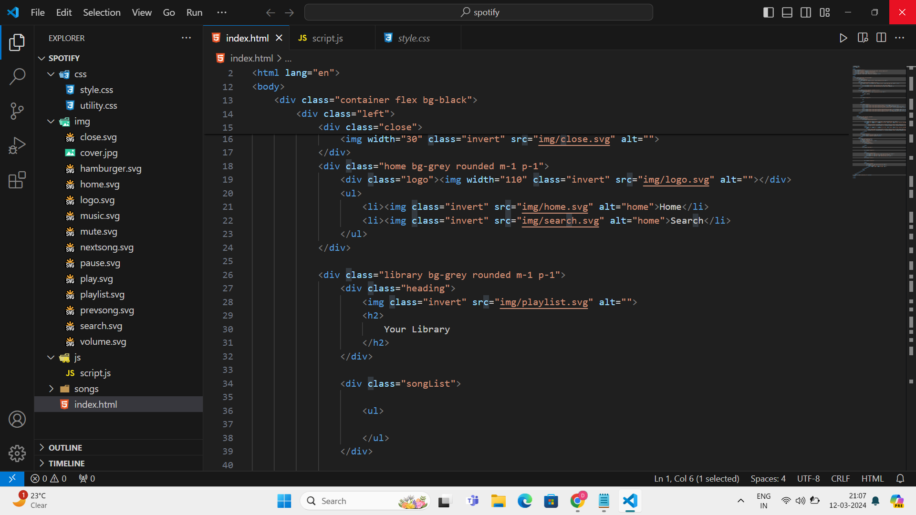
Project Highlights : 1
Here is some snapshots of html,css and javascript code that we use in our spotify clone project:

Slide 10
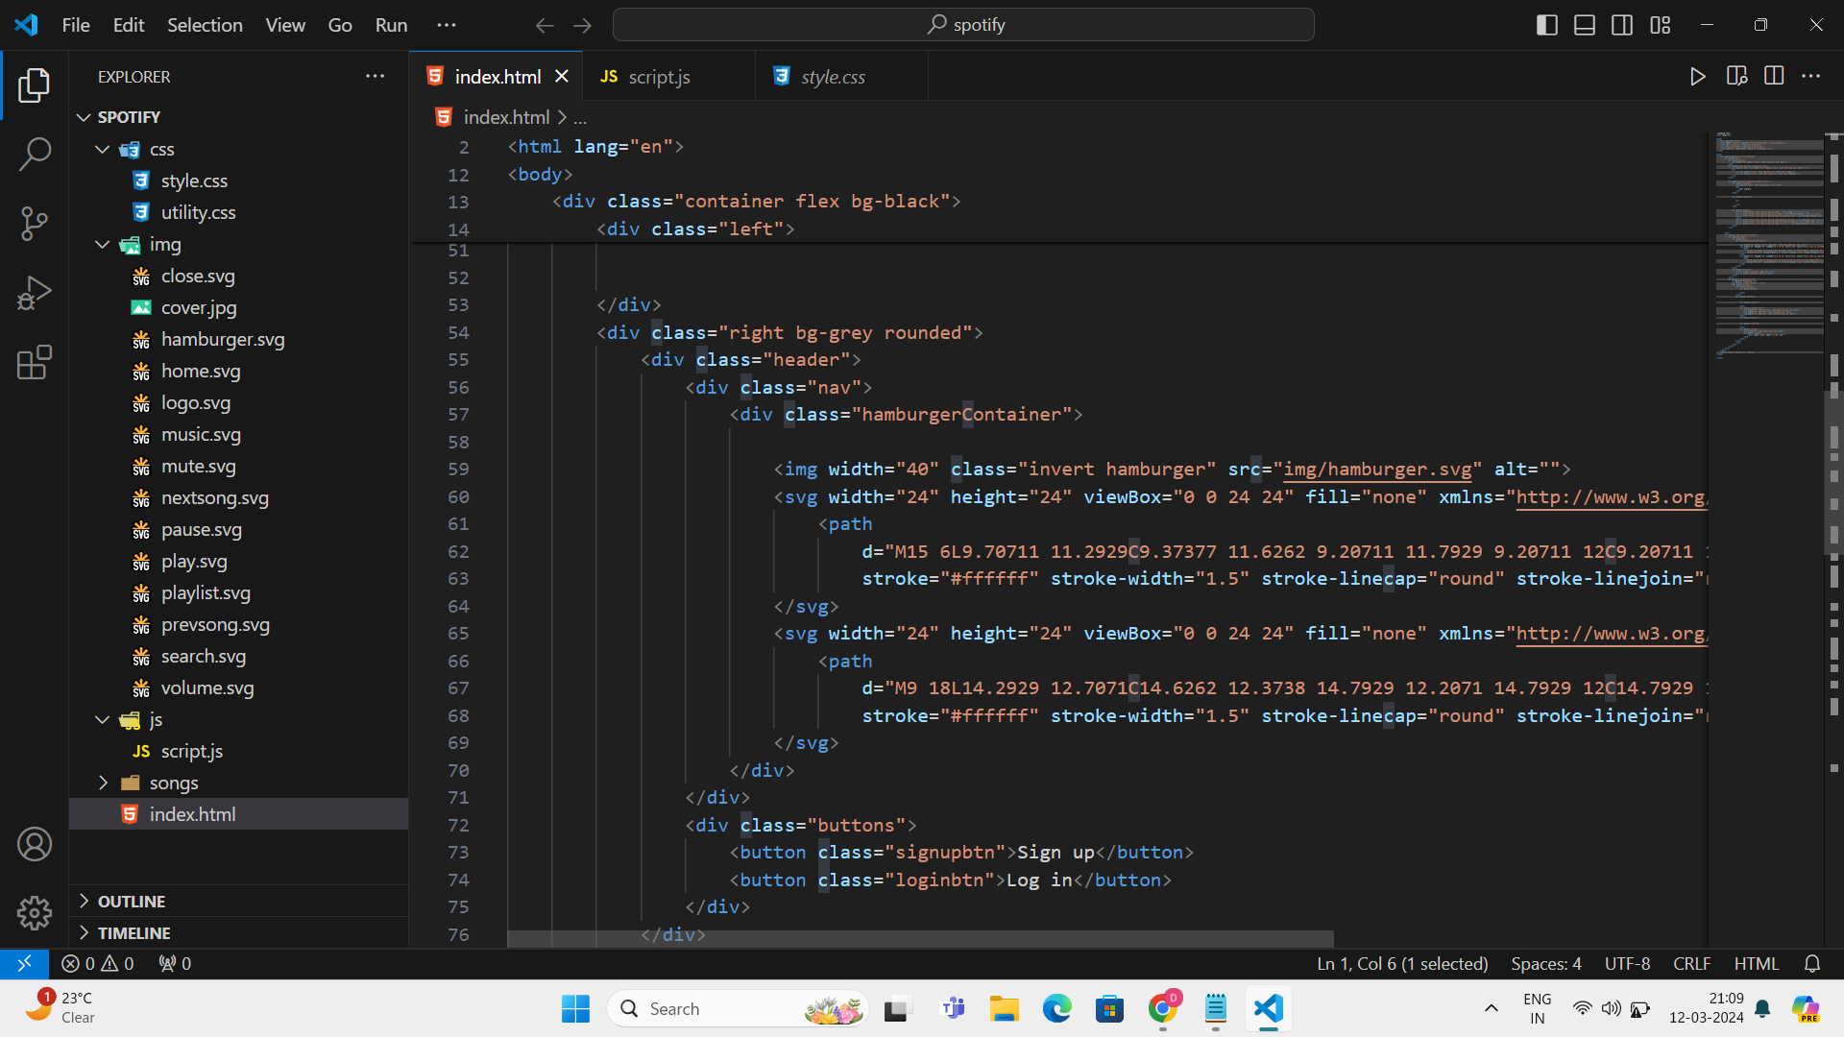

Slide 11
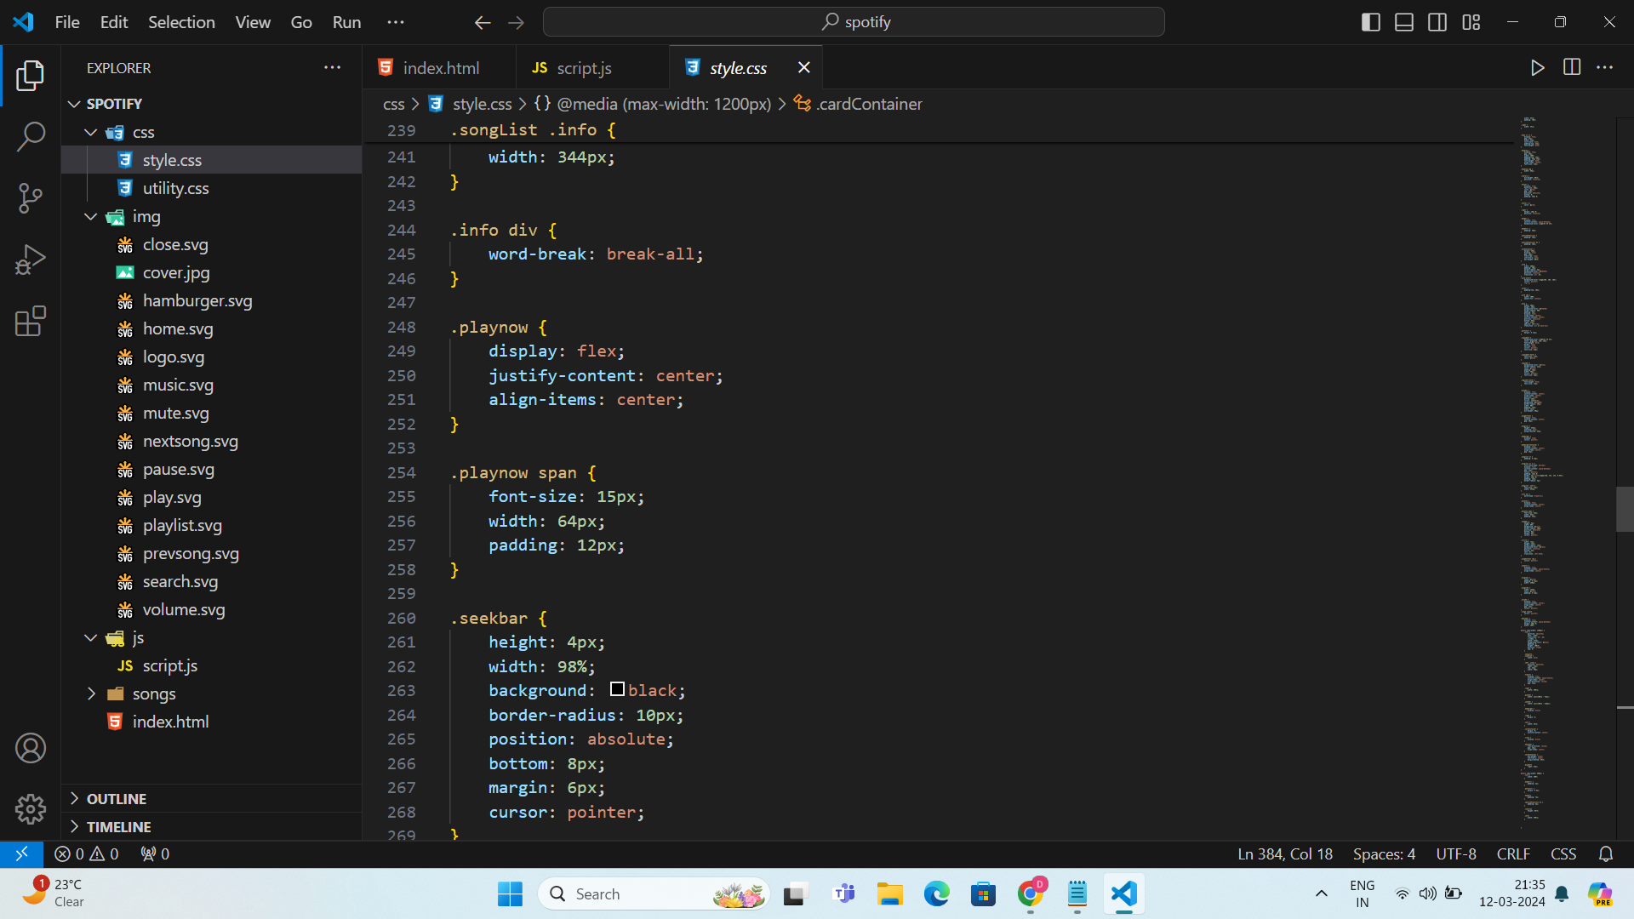
Project Highlights : 2 (CSS)

Slide 12
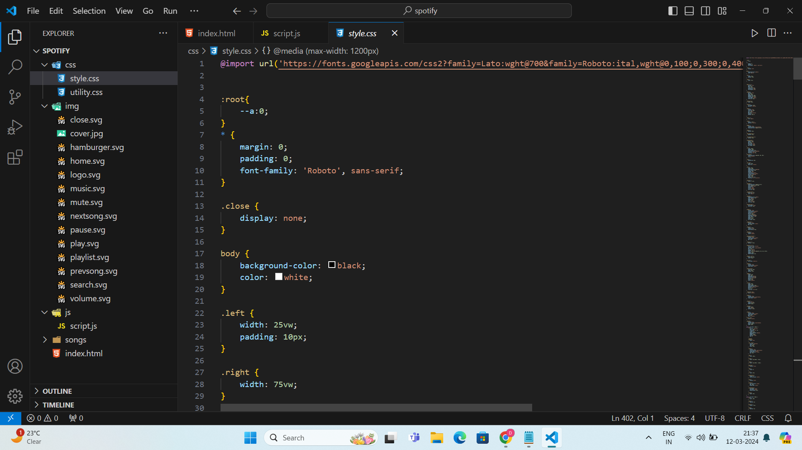

Project Highlights : 2 (CSS)

Slide 13
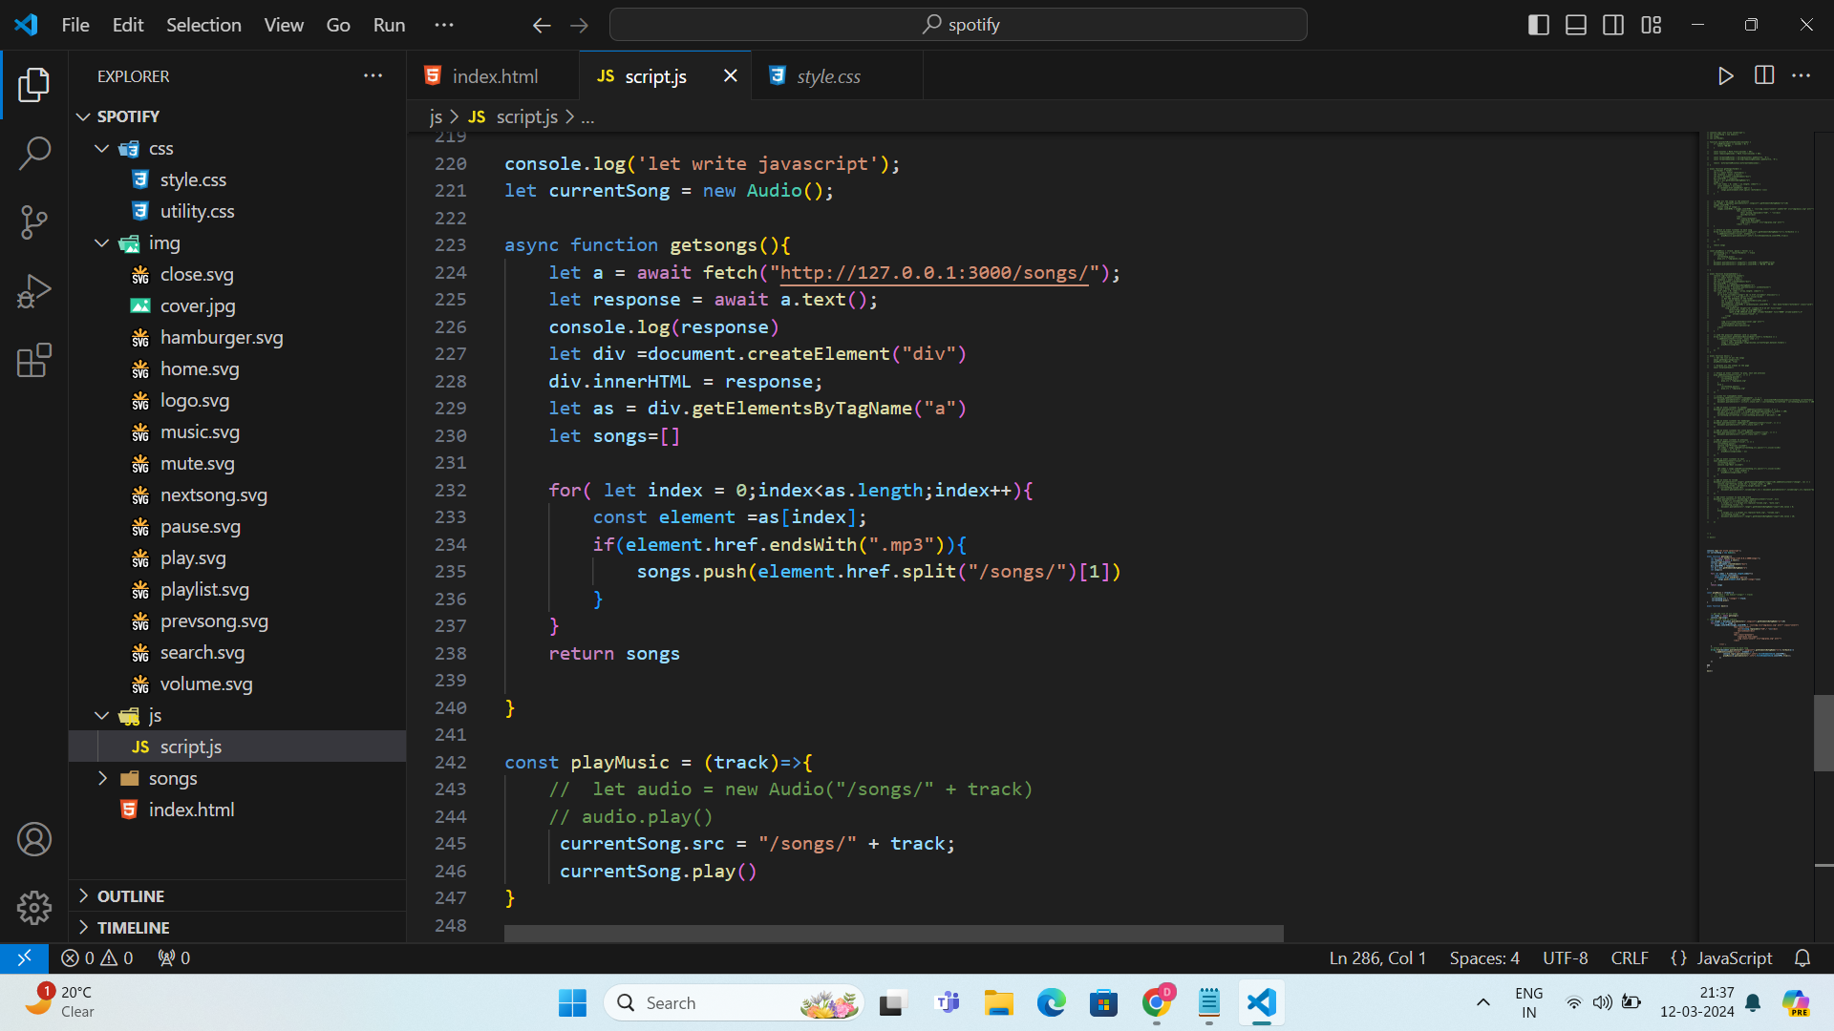
Project Highlights : 3 (JS)

Slide 14
Conclusion/Theme Plan
" Providing music lovers with a platform they will enjoy using, focusing on fun exploration of new songs, playlist creation, and hassle-free enjoyment of favorite tunes"
- **Technological Integration**: Utilizing HTML, CSS, and JavaScript for seamless integration, resulting in a user-friendly and visually appealing interface. - **Functionality**: The interface mirrors the functionality of existing music streaming services, ensuring familiarity for users. - **Commitment to Improvement**: Continuously working to ensure the platform remains easy to use and brings joy to all music enthusiasts.

Slide 15
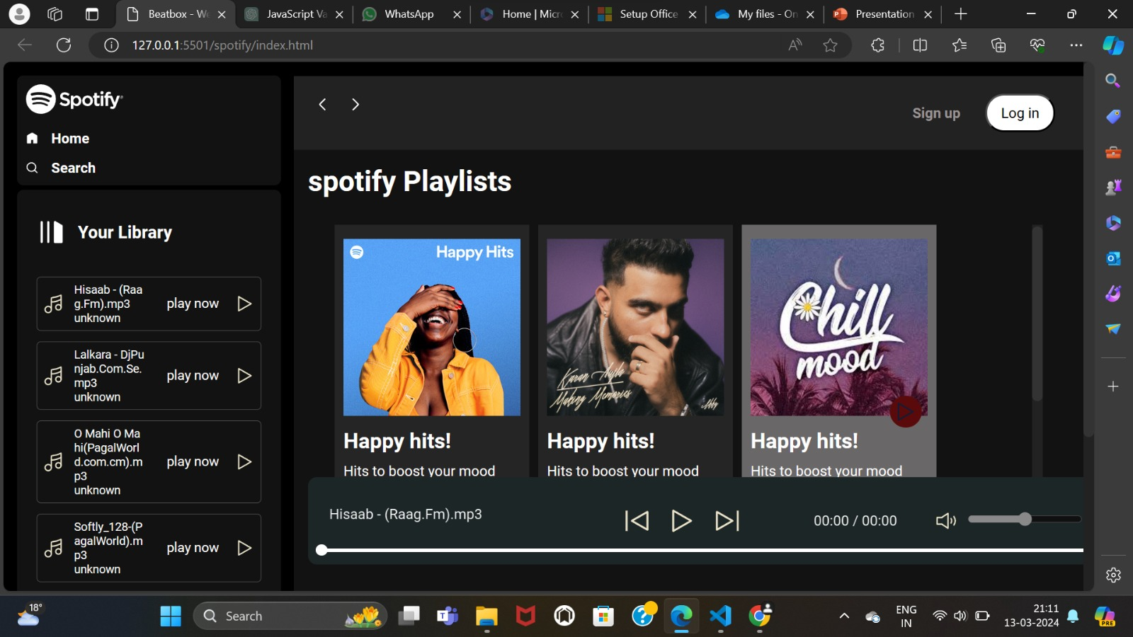
How it looks like

Slide 16
References
https://www.w3schools.com/js/
https://stackoverflow.blog/2019/09/12/practical-ways-to-write-better-javascript/
https://github.com/CodeWithHarry

Slide 17
Thank You

